Slide 1
World Happiness Report EDA
Jennifer Ruiz
DSC 530

Slide 2
Background

Slide 3
Background Information
The World Happiness Report is a landmark measure of happiness around the globe.
The survey is administered annually to 158 countries.
This analysis focuses on the 2015 World Happiness Report
A link to the full dataset can be found here:
https://www.kaggle.com/unsdsn/world-happiness#2015.csv

Slide 4
Research Questions
Are there any trends in Happiness rank based on Region?
What influence do Freedom and Trust have upon the Happiness Rank?
What impact does Health have on Happiness rank?
How does GDP impact the Happiness Score?
Which variables have the most significant impact upon the Happiness Score?

Slide 5
The Data

Slide 6
Variables of Interest
Happiness Score: ranking of Happiness on scale of 1-10
Happiness Rank: Final Rank of Each Country
Country: Name of Each Participating Country
Region: Geographical Region
Economy (GDP): measures the economy of the country
Health: Measure of Life Expectancy for each country
Freedom: Level of Liberty for each country
Trust: measures government corruption

Slide 7
Outliers
Each of the five main variables chosen contain outliers. After reviewing the data and associated histograms, the decision was to keep outliers within the dataset as they are key to a full analysis.

Slide 8
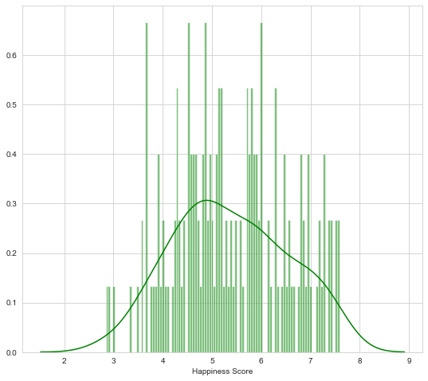
Happiness Score
Mean: 5.38
Mode: 5.19
Std: 1.15
Min value: 2.84
Max value: 7.58
Distribution: the distribution is slightly positively skewed

Slide 9
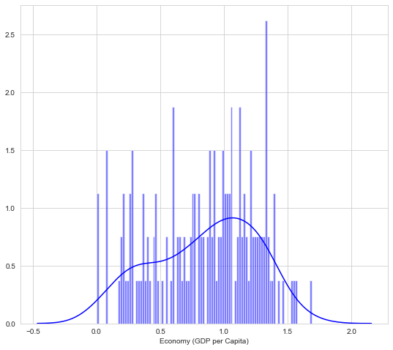
Economy (GDP)
Mean: 0.85
Mode: multiple modes
Std: 0.40
Min Value: 0.00
Max Value: 1.69
Distribution: the distribution has a slight negative skew

Slide 10
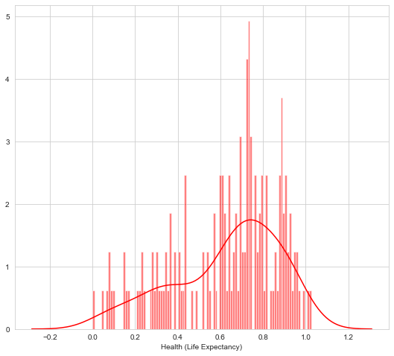
Health (Life Expectancy)
Mean: 0.63
Mode: 0.92
Std: 0.25
Min Value: 0.00
Max Value: 1.02
Distribution: the distribution is negatively skewed

Slide 11
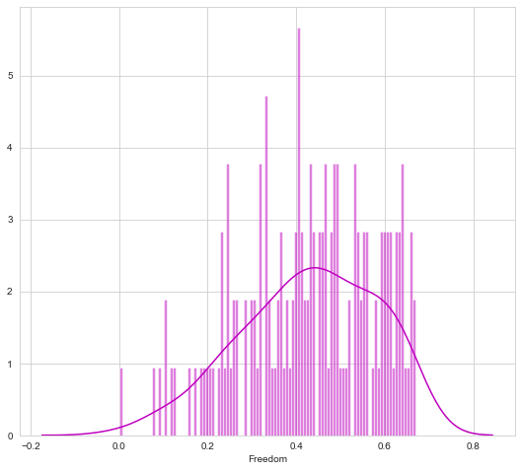
Freedom
Mean: 0.43
Mode: Multiple Modes
Std: 0.15
Min Value: 0.00
Max Value: 0.67
Distribution: the distribution is has a slight negative skew

Slide 12
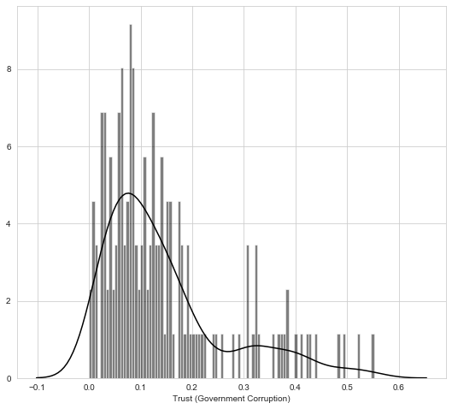
Trust (Government Corruption)
Mean: 0.14
Mode: 0.33
Std: 0.12
Min Value: 0.00
Max Value: 0.55
Tails: Distribution is positively skewed

Slide 13
Analysis

Slide 14
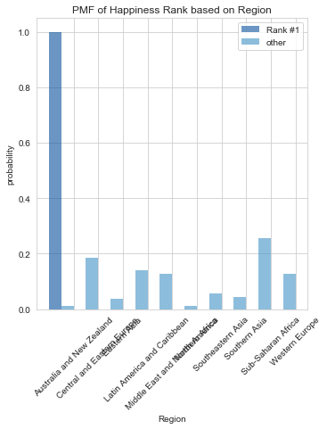
PMF of Happiness Rank based on Region
Based on the PMF, Western Europe tends to have the highest happiness rankings, while the Middle East/ North Africa and Australia/New Zealand tend to have the lowest happiness rankings.

Slide 15
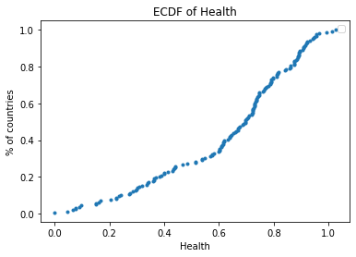
CDF of Health
The CDF indicates that 40% of the countries surveyed have a Life Expectancy less than 60 years (0.6).
80% of countries have a life expectancy less than 80 years.
20% of countries have a life expectancy greater than 80 years.
Less than 1% of countries have a life expectancy of more than 100 years.

Slide 16
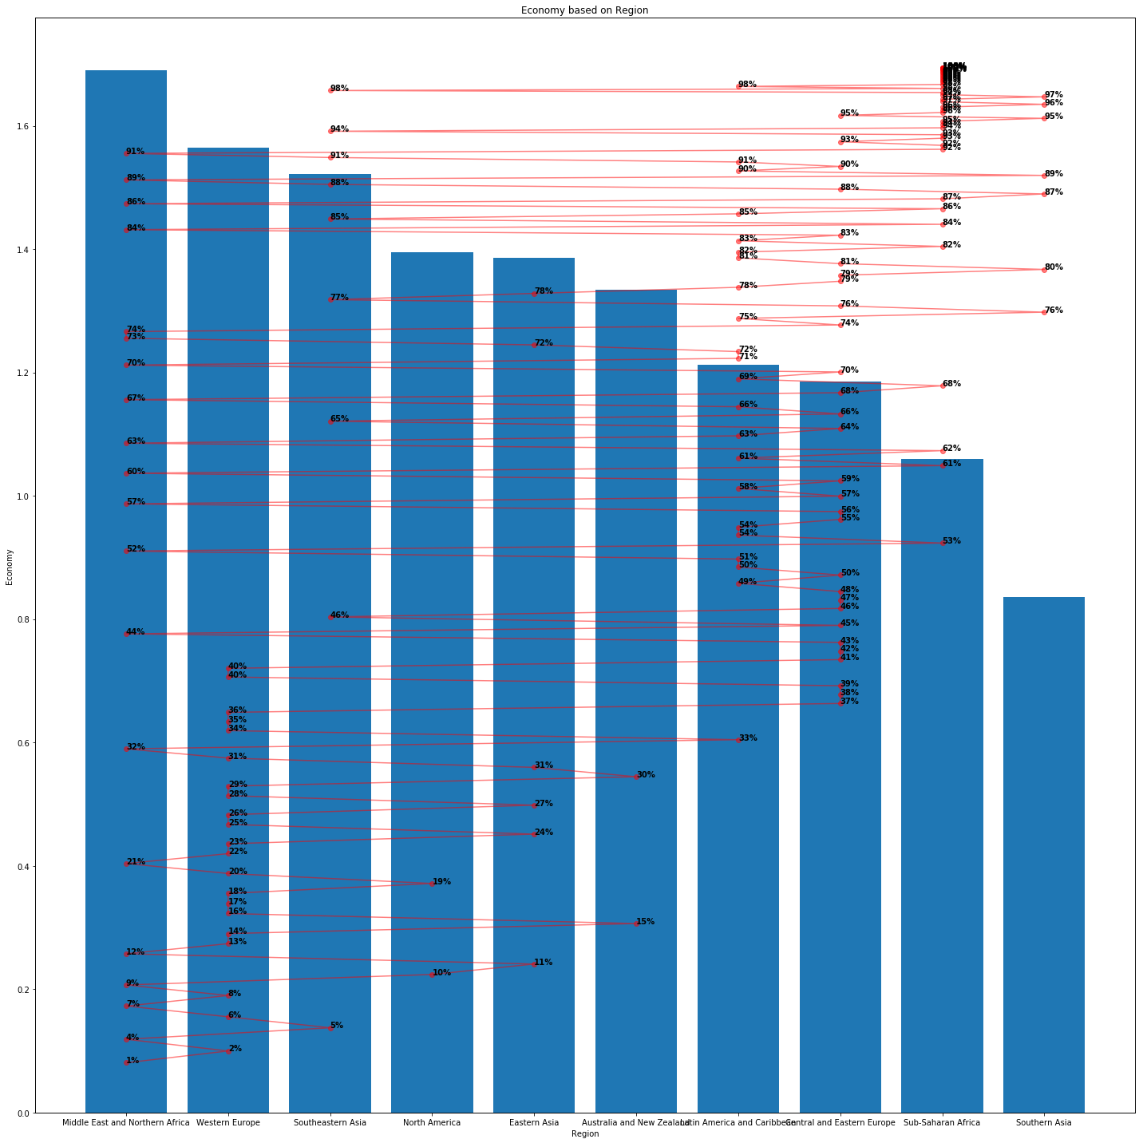
Pareto Distribution of Economy (GDP)
The pareto plot reveals that the Middle East and North Africa have the highest GDP of the countries surveyed.
Southeast Asia has the lowest GDP of the countries surveyed.
North America and Eastern Europe have similar GDP values.

Slide 17
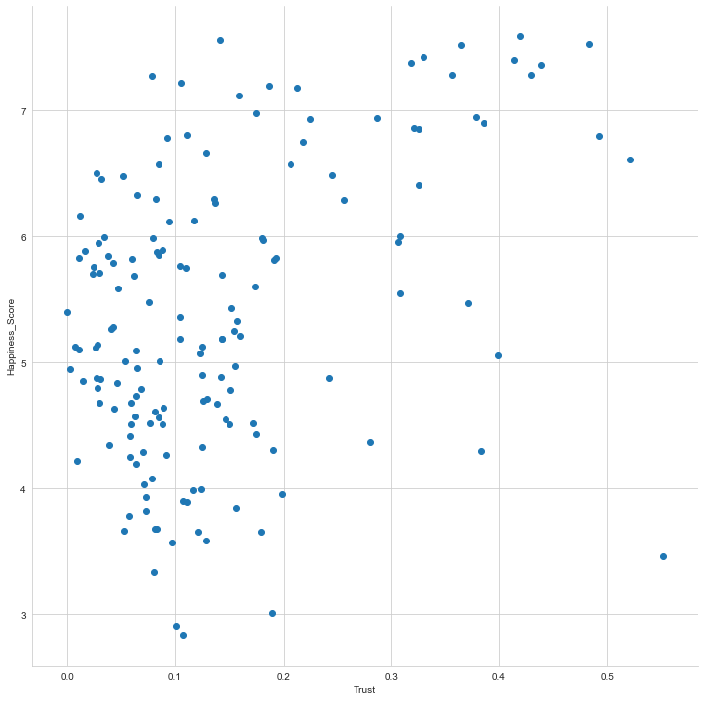
Trust vs. Happiness Score
It seems that Trust (the level of government Corruption) has a mild, positive effect on Happiness Score.
Correlation: 0.40
Covariance: 0.05

Slide 18
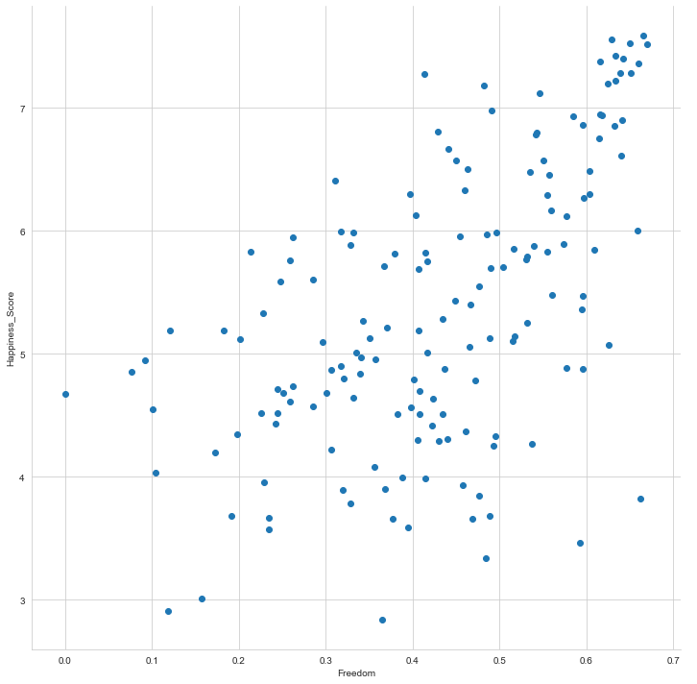
Freedom vs. Happiness
Freedom has a moderate positive correlation with the Happiness Score of countries surveyed.
Correlation: 0.58
Covariance: 0.10

Slide 19
Chi Squared Test for Country and Region
A chi-squared test was conducted to identify any association between Country and Region.
Hypothesis: Country and Region are associated with one another.
Result: There is no association between country and region.
Significance Level: 0.05
df: 1413
p-value: 1.0
Critical value: 1501.56

Slide 20
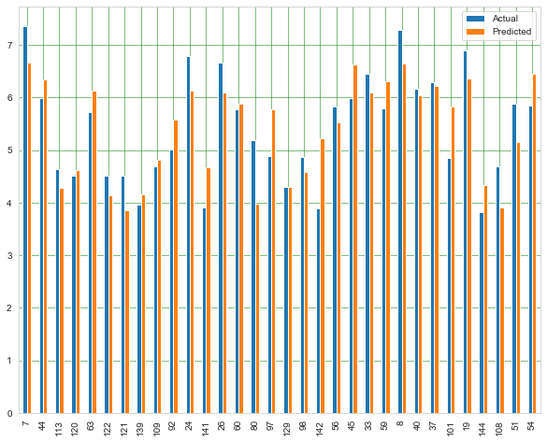
Multiple Regression
A multiple regression model was created to investigate the degree to which Economy, Family, and Health predict Happiness Score.
R^2: 0.72
The high R-squared value and low std error for each factor indicate the model is a good fit for the data.

Slide 21
Conclusion

Slide 22
Final Remarks
Through this analysis, several factors seem to have a strong relationship with the Happiness Score. The top three were: Economy, Family, and Health.
This analysis produced compelling insights and warrants future investigation with more in-depth analysis.

